Slide 1
Lecture 2 - Types and Objects
Programming
Principles and Practice Using C++
Shengfa Wang
sfwang@dlut.edu.cn

Slide 2
Class and Object
Class
Object
Sandy
Jack
property：
name；
gender ;
…
action ：
run；
jump；
talk；
…
property：
name=Sandy;
gender =F;
…
action ：
run；
jump；
talk；
…
property：
name=Jack;
gender=M ;
…
action ：
run；
jump；
talk；
…

Slide 3





OOP
OOP Character
1
2
3
Encapsulation ：
student
teacher
test paper
Inheritance :
person
student
teacher
Polymorphism :
Sandy.examination（）
Jack.examination（）
Teacher tests students
Notes:
封装：一是把对象的全部属性和行为结合在一起，形成一个不可分割的独立单位；二是尽可能隐蔽对象的内部属性和实现细节，对外形成一道屏障，与外部的联系只能通过公共接口实现。
继承：子类自动共享父类数据和方法的机制，它由类的派生体现。一个子类直接继承父类的全部描述，同时可修改和扩充，继承是对父类的重用机制。
多态性：是在继承体系结构中，同一消息为不同的对象接受时可产生完全不同的行动。利用多态性用户可发送一个通用的信息，而将所有的实现细节都留给接受消息的对象自行决定。

Slide 4
Introduction
Basics about types and objects
Input/output in C++
Vector
  Container/Iterator – Generic programming
Notes:
The notion of type is central to C++ and most other programming languages. We are going to take a closer and slightly more technical look at types, specifically at the types of the objects in which we store our data during computation.

Slide 5
Types
C++ provides a set of types
  E.g. bool, char, int, double
  Called “Built-In or Fundamental Data types”
C++ programmers can define new types
  Called “Derived or User-Defined Data types”
  E.g. class, struct
The C++ standard library provides a set of types
  E.g. string, vector, complex
  Technically, these are user-defined types
    they are built using only facilities available to every user
Notes:
There are many data-types available in C++. They are classified under two categories: Built-In or Fundamental Data types and Derived or User-Defined Data types
Built-in data types
Built-in data types are the most basic data-types in C++.
The term built-in means that they are pre-defined in C++ and can be used directly in a program.
char, int, float and double are the most common built-in data types.
Apart from these, we also have void and bool data types.
Derived data types
User-defined data types are those which are first declared and defined by the user before use.
They are composed of built-in data types.
Examples are : array, structure, union, class, pointers etc
In this post, we will be dealing with built-in data types. User-defined data types will be presented in detail in further posts.

Slide 6
The various built-in data types
1. int data type
  The int data type is used for integers. Integers are numbers with no decimal point. For example : 24, -90, 1234, 0 etc.
2. float data type
  This data type is used for numbers that have a decimal point which are commonly called floating-point numbers. For example: 76.45, 12.4, -90.6 etc.
3. double data type
  This data type is also used for floating-point numbers.
  But the difference is that the range and precision of this data type is greater than that of float. In other words, it is used for large floating-point numbers, the ones that do not fit in the scope of the float data type.
4. char data type
  This data type is used for characters. It can be used for any valid character in C++ and not just alphabets.
Two special data types: bool and void
bool data type:
  bool refers to boolean. This data type has only two values: true and false.
void data type:
  The word void means empty. So it has no value. This is used as return type for functions that do not return a value.
Notes:
1-true 0-false

Slide 7
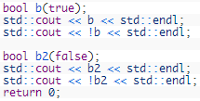
bool
Boolean variables only have two possible values: true (1) and false (0).

Slide 8

std::boolalpha
This prints:
1
0
true
false

Slide 9
Built-in data types
An object is some memory that can hold a value of a given type
A variable is a named object
A declaration is a statement that gives a name of an object
int a = 7;
char c = 'x';
complex<double> z(1.0,2.0);
string s = "qwerty";
a:
7
c:
'x'
z:
1.0
2.0
s:
6
"qwerty"
Notes:
An int box can hold integers, such as 7 here, and a string box can hold character string values such as qwerty.

Slide 10
Assignment and increment
a:
// changing the value of a variable
int a = 7; // a variable of type int called a
// initialized to the integer value 7
a = 9; // assignment: now change a's value to 9
a = a+a; // assignment: now double a's value
a += 2; // increment a's value by 2
++a; // increment a's value (by 1)
7
9
18
20
21

Slide 11
A technical detail
In memory, everything is just bits; type is what gives meaning to the bits
  (bits/binary) 01100001 is the int 97 is the char 'a'
  (bits/binary) 01000001 is the int 65 is the char 'A'
  (bits/binary) 00110000 is the int 48 is the char '0'
  char c = 'a';
  cout << c; // print the value of character c, which is a
  int i = c;
  cout << i; // print the integer value of the character c, which is 97
This is just as in “the real world”:
  What does “42” mean?
  You don’t know until you know the unit used
    Meters? Feet? Degrees Celsius? $s? a street number? Height in inches? …

Slide 12
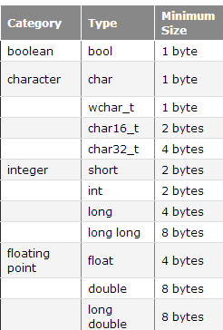
Variable sizes
a byte can store 2⁸ (256) possible values.
The size of the variable puts a limit on the amount of information it can store
C++ guarantees that the basic data types will have a minimum size
actual size of the variables may be different on your machine: sizeof operator
Beware of assigning an out-of-range value
Notes:
1 byte = 8bit

Slide 13
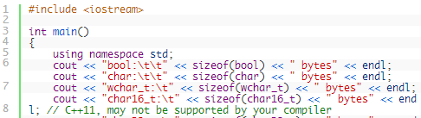
the sizeof operator
a unary operator that takes either a type or a variable, and returns its size in bytes.
Notes:
If you’re wondering what ‘\t’ is in the above program, it’s a special symbol that inserts a tab (in the example, we’re using it to align the output columns). We will cover ‘\t’ and other special symbols when we talk about the char data type.

Slide 14
A type-safety violation
implicit narrowing
// Beware: C++ does not prevent you from trying to put a large value
// into a small variable (though a compiler may warn)
int main()
{
int a = 20000;
char c = a;
int b = c;
if (a != b) // != means “not equal”
cout << "oops!: " << a << "!=" << b << '\n';
else
cout << "Wow! We have large characters\n";
}
Try it to see what value b gets on your machine
a
20000
c:
???
Notes:
说明代码习惯问题{} there are ways of doing operations that are not type-safe. For example, using a variable before is has been initialized is not considered type-safe.
Complete type safety is the ideal, and a c++ compiler cannot guarantee complete type safety, but we can avoid type safety violation through combination of good coding practice and run-time checks.

Slide 15
A type-safety violation
Uninitialized variables
// Beware: C++ does not prevent you from trying to use a variable
// before you have initialized it (though a compiler typically warns)
int main()
{
int x; // x gets a “random” initial value
char c; // c gets a “random” initial value
double d; // d gets a “random” initial value
double dd = d; // potential error: some implementations
// can’t copy invalid floating-point values
cout << " x: " << x << " c: " << c << " d: " << d << '\n';
}
Always initialize your variables – beware: “debug mode” may initialize (valid exception to this rule: input variable)
Notes:
For example, using a variable before is has been initialized is not considered type-safe

Slide 16
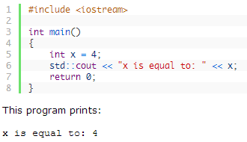
Cout
the std::cout object (in the iostream library) can be used to output text to the console.
To print more than one thing on the same line, the output operator (<<) can be used multiple times. For example:

Slide 17
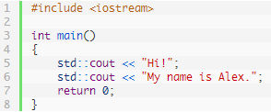

Cout
What would you expect this program to print?
Hi!My name is Alex.
Notes:
You might be surprised at the result:

Slide 18
Input and output
// read first name:
#include "std_lib_facilities" // our course header, page 53
int main()
{
cout << "Please enter your first name (followed " << "by 'enter'):\n";
string first_name;
cin >> first_name;
cout << "Hello, " << first_name << '\n';
}
// note how several values can be output by a single statement
// a statement that introduces a variable is called a declaration
// a variable holds a value of a specified type
// the final return 0; is optional in main()
// but you may need to include it to pacify your compiler

Slide 19
Input and type
cout << "Please enter your first name (followed " << "by 'enter'):\n";
string first_name;
cin >> first_name;
cout << "Hello, " << first_name << '\n’;
We read into a variable
  Here, first_name
A variable has a type
  Here, string
The type of a variable determines what operations we can do on it
  Here, cin>>first_name; reads characters until a whitespace character is seen
  White space: space, tab, newline, …

Slide 20
String input
// read first and second name:
int main()
{
cout << "please enter your first and second names\n";
string first;
string second;
cin >> first >> second; // read two strings
string name = first + ' ' + second; // concatenate strings
// separated by a space
cout << "Hello, "<< name << '\n';
}
// Several values can be input by a single statement
//The type of a variable determines what operations we can do on it

Slide 21
Integers
// read name and age:
int main()
{
cout << "please enter your first name and age\n";
string first_name; // string variable
int age; // integer variable
cin >> first_name >> age; // read
cout << "Hello, " << first_name << " age " << age << '\n';
}
// We use identical statements for objects with various types.
// The type of a variable determines what operations we can do on it

Slide 22
Integers and Strings
Strings
  cin >> reads (until whitespace)
  cout << writes
  + concatenates
  += s adds the string s at end
  ++ is an error
  - is an error
  …
Integers and floating point numbers
  cin >> reads a number
  cout << writes
  + adds
  += n increments by the int n
  ++ increments by 1
  - subtracts
  …
The type of a variable determines which operations are valid and what their meanings are for that type
  (that's called "overloading" or "operator overloading")

Slide 23
Using Vectors to Collect Data Items
Suppose you write a program that read in a list of salary figures and print the list, and markthe highest value, like this:
32000
54000
67500
29000
35000
80000
highest value => 115000
44500
100000
65000
All the values need to be read to find the highest one.
If you know there are ten inputs, you could use 10 variables salary1, salary2, ... , salary10.
You would have to write a lot of code ten times to handle each variable.
This technique becomes prohibitive as the list gets larger (e.g., 100 salaries …).

Slide 24
Array and Vector
Arrays contain a specific number of elements of a particular type. You must specify the type and number of elements that the array will contain when it is defined.
Fundamental problem
  We (humans) want abstractions that can change size . However, in computer memory everything must have a fixed size, so how do we create the illusion of change?

Slide 25
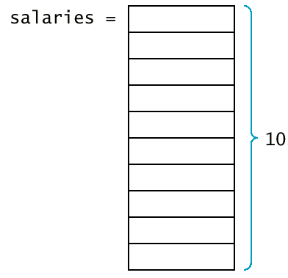
Using Vectors to Collect Data Items
A vector is a collection of data items of the same type.
vector<double> salaries(10);
This vector holds 10 values, each of which are double.
A vector is a dynamically sized sequence of objects that provides array-style
Notes:
Just like arrays, vectors use contiguous storage locations for their elements, which means that their elements can also be accessed using offsets on regular pointers to its elements, and just as efficiently as in arrays. But unlike arrays, their size can change dynamically, with their storage being handled automatically by the container.

Slide 26
Using Vectors to Collect Data Items
(Syntax 9.1 Vector Variable Definition)
Syntax
vector<type_name> variable_name vector<type_name> var_name(initial_size);
Example:
vector<int> scores;
vector<string> staff(20);
Purpose:
  Define a new variable of vector type, and optionally supply an initial size.

Slide 27
Using Vectors to Collect Data Items
You must specify which slot you want to use with the [] operator.
Example:
salaries[4] = 35000;
The number inside the brackets is called an index.
Because salaries is a vector of double values, a slot such as salaries[4] can be used just like any variable of type double.
Example:
  cout << salaries[4] << "\n";

Slide 28
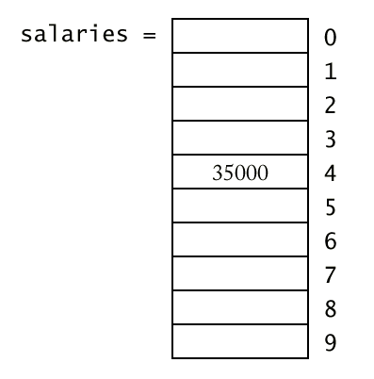
Using Vectors to Collect Data Items (cont.)
In C++, the slots of vectors are numbered starting at 0.

Slide 29
Syntax : Vector Subscripts
General Syntax vector_expression[integer_expression]
Example:
salaries[i + 1]
  refers to the element in position given by the value of expression i+1
Purpose:
  Access and element in a vector.
Notes:
elements can also be accessed using offsets on regular pointers to its elements, and just as efficiently as in arrays.

Slide 30
Vector Subscripts
Trying to access a slot that does not exist in the vector is an error.
Example:
vector<double> staff(10);
cout << staff[10];
/* legal subscripts are 0 until 9 */
The C++ standard implementation of vector generates no error message.
If you make an index error, you silently read or overwrite another memory location.
When a vector is defined without a size parameter, it is empty and can hold no elements.
Example:
vector<double> salaries; /* no size given */
salaries[0] = 35000;

Slide 31
Vector Subscripts
You can find the size vector by calling the size function.
for(i = 0; i < v.size(); i++)
do something with v[i];
The function push_back allows you to start out with an empty vector and grow the vector whenever another element is added.
vector<double> salaries;
. . .
double s;
cin >> s;
. . .
salaries.push_back(s);
Notes:
unlike arrays, their size can change dynamically, with their storage being handled automatically by the container.

Slide 32
Vector Subscripts (cont.)
The push_back command resizes the vector by adding one element to its end.
If you already know how many elements you need in a vector, you should specify that size when you define it.
Another member function, pop_back, removes the last element of a vector, shrinking its size by one.
salaries.pop_back();
/* Now salaries has size 9 */
The standard defines many more useful functions for vectors;

Slide 33
Data for Iteration - Vector
To do just about anything of interest, we need a collection of
data to work on. We can store this data in a vector. For example:
  // read some temperatures into a vector:
  int main()
  {
  vector<double> temps; // declare a vector of type double to store // temperatures – like 62.4
  double temp; // a variable for a single temperature value
  while (cin>>temp) // cin reads a value and stores it in temp
  {
  temps.push_back(temp); // store the value of temp in the vector
  }// … do something …
  }
  // cin>>temp will return true until we reach the end of file or encounter
  // something that isn’t a double: like the word “end”

Slide 34
Vector
Vector is the most useful standard library data type
  A vector is simply a sequence of elements that you can access by an index
  a vector<T> holds an sequence of values of type T
  Think of a vector this way
  A vector named v contains 5 elements: {1, 4, 2, 3, 5}:
size()
v:
5
v[0]
v[1]
v[2]
v[3]
v[4]
v’s elements:
1
4
2
3
5
Notes:
The first element has index 0, and the second index is 1 and so on. We refer to an element by subscripting the name of the new vector with the element’s index….
We see that to make a vector we need to specify the type of the elements and the initial number of elements,
The element type comes after vector in angle brackets,

Slide 35
Vector
vector<int> v; // start off empty
v.push_back(1); // add an element with the value 1, and v now has one element, which is v[0]=1
v.push_back(4); // add an element with the value 4 at end (“the back”)
v.push_back(3); // add an element with the value 3 at end (“the back”)
v[0] v[1] v[2]
v:
0
v:
1
1
v:
2
1
4
v:
3
1
4
3
Notes:
Often we start a vector empty and grow it to its desired size as we read or compute the data we want in it.
The key operation here is push_back(), this could add a new element to a vector. And the new element becomes the last element of the vector.
For example we start off empty, and we want to add an element with the value 1 at the end of v. _x0016__x0016_and v now has one element, which is v[0]=1.

Slide 36
Vectors
Once you get your data into a vector you can easily manipulate it:
  // compute mean (average) and median temperatures:
  int main()
  {
  vector<double> temps; // temperatures in Fahrenheit, e.g. 64.6
  double temp;
  while (cin>>temp)
  {
  temps.push_back(temp); // read and put into vector
  }
  double sum = 0;
  for (int i = 0; i< temps.size(); ++i)
  sum += temps[i]; // sums temperatures
  cout << "Mean temperature: " << sum/temps.size() << endl;
  sort(temps.begin(),temps.end());
  cout << "Median temperature: " << temps[temps.size()/2] << endl;
  }

Slide 37
Combining Language Features
You can write many new programs by combining language features, built-in types, and user-defined types in new and interesting ways.
  So far, we have
    Variables and literals of types bool, char, int, double
    vector, push_back(), size()
    !=, ==, =, +, -, +=, <, &&, ||, !
    max( ), sort( ), cin>>, cout<<
    if, for, while
  You can write a lot of different programs with these language features! Let’s try to use them in a slightly different way…

Slide 38
Example – Word List
/*
read a bunch of strings into a vector of strings, sort
them into lexicographical order (alphabetical order),
and print the strings from the vector to see what we have.
*/
vector<string> words;
string s;
while (cin>>s && s != "quit") // && means AND
{
words.push_back(s);
}
sort(words.begin(), words.end()); // sort the words we read
for (int i=0; i<words.size(); ++i)
{
cout<<words[i]<< "\n";
}

Slide 39
Word list – Eliminate Duplicates
// Note that duplicate words were printed multiple times. For
// example “the the the”. That’s tedious, let’s eliminate duplicates:
vector<string> words;
string s;
while (cin>>s && s!= "quit")
words.push_back(s);
sort(words.begin(), words.end());
for (int i=1; i<words.size(); ++i)
if(words[i-1]==words[i])
“get rid of words[i]” // (pseudocode)
for (int i=0; i<words.size(); ++i)
cout<<words[i]<< "\n";
// there are many ways to “get rid of words[i]”; many of them are messy
// (that’s typical). Our job as programmers is to choose a simple clean
// solution – given constraints – time, run-time, memory.

Slide 40
Example (cont.) Eliminate Words!
// Eliminate the duplicate words by copying only unique words:
vector<string> words;
string s;
while (cin>>s && s!= "quit") words.push_back(s);
sort(words.begin(), words.end());
vector<string>w2;
if (0<words.size())
{ // Note style { }
w2.push_back(words[0]);
for (int i=1; i<words.size(); ++i)
{
if(words[i-1]!=words[i])
w2.push_back(words[i]);
}
}
cout<< "found " << words.size()-w2.size() << " duplicates\n";
for (int i=0; i<w2.size(); ++i) cout << w2[i] << "\n";

Slide 41
Algorithm
We just used a simple algorithm
We eliminated the duplicates by first sorting the vector (so that duplicates are adjacent), and then copying only strings that differ from their predecessor into another vector.
An algorithm is (from Google search)
  “a logical arithmetical or computational procedure that, if correctly applied, ensures the solution of a problem.” – Harper Collins
  “a set of rules for solving a problem in a finite number of steps, as for finding the greatest common divisor.” – Random House

Slide 42
Exercise
Read chapters 1-5
Exercises 3, 5, 8, 19

